Slide 1

Welcome to Programming Fundamentals INFO-1150
Week 11
Wednesday, November 12, 2014
Room R1021

Slide 2
Recall: Accessing Array Elements
//Creation and initialization of an array
int[] numbers = {6, 5, 4, 12, -2, 14};
Use a for loop to access all elements in sequence, substituting the x for each index:
for(int x = 0; x < numbers.length; x++)
{
System.out.println(numbers[x]);
sum += numbers[x];
}
“length” stores the number of elements in the array

Slide 3
Enhanced for Loop
A shortcut version of the for loop
Designed to automatically iterate once for each element in an array
Each time the loop iterates, it copies an element to a variable
//Creation and initialization of an array
int[] numbers = {6, 5, 4, 12, -2, 14};
//The loop iterates the length of the array and with each iteration x is assigned an element value
for (int num : numbers)
{
System.out.println(num);
sum += num;
}
Variable used to hold each array element during array processing
Automatically iterates for each element in array

Slide 4
Enhanced for Loop vs. Traditional for Loop
Use the enhanced for loop, when you want to access every element in an array, from first to last
Advantages:
You don’t need to consider the array’s length
You don’t have to create an index variable to hold indexes
Use the traditional for loop, when you need to:
Change array elements
Traverse an array in reverse
Access only some of the array elements
Work with two or more arrays at once
Refer to the index of a particular element

Slide 5
Introduction to Methods
Your programs have become more complex
Instead of writing one long program, write methods
A method:
Is a sequence of instructions that performs a task
Contains the solution to a subtask
Why Use Methods?
To handle complicated programs in easy-to-handle chunks
To group code into modules (methods) by functionality
To reuse code multiple times inside your program
Using methods provides a “divide and conquer” approach to coding!

Slide 6
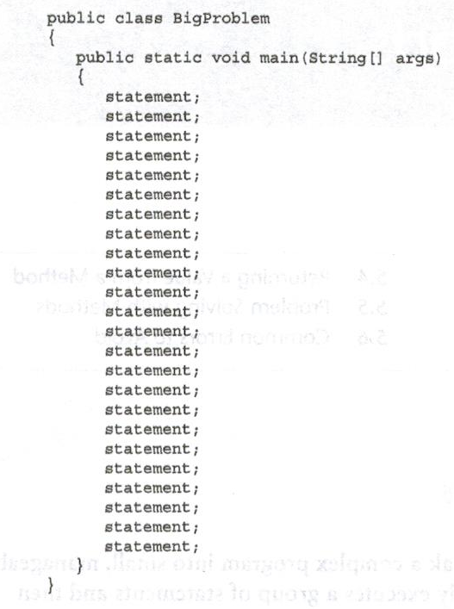
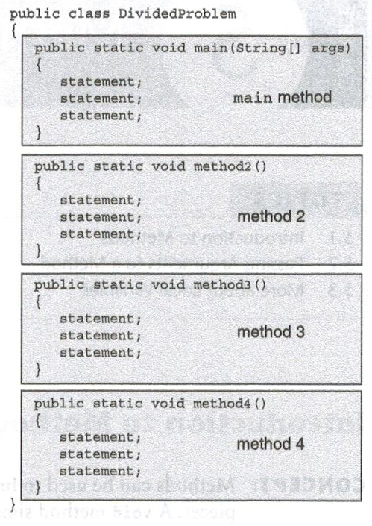
What does this “divide and conquer” approach look like?

Slide 7
Program Planning
What should you ask yourself when solving a problem?
Ask yourself . . .
What tasks are to be done
In what order should the tasks be done
What should be done first?
How will you do this?
Begin with an algorithm:
A step-by-step solution to solving a program usually written English

Slide 8
Project 1
Look at the handout for Project 1 on FOL
In Eclipse:
Create 2 Projects with multiple classes:
Project1WorkingVersions
Version1RestaurantOrder.java
Version2RestaurantOrder.java
Project2FinalVersion
BackupVersionRestaurantOrder.java
J_M_RestaurantOrder.java

Slide 9
Project 1 (might contain over 300 lines of code)
Display title
Fill the menu arrays
Get the number of diners in the group
Get the names of the diners
Generate the food order for each diner
For the first diner:
Display a menu
Get choice
Validate choice
Update order amount
Update order display
Continue for each menu . . . .
Display diner’s dinner order
Update billing array
Repeat for all diners . . . .
Get number of bills
Calculate hst
Calculate tip
Calculate total bill

Slide 10
Creating Methods
Two types of methods:
Command Method
Does a task but does not return a value
public static void printTitle()
Query Method
Does a task and returns a value
public static int findAverage (int [] numbers)

Slide 11
Practice Coding:
NumberGuessGame.java
NameBackwards.java
Palindrome.java

Slide 12
About Math.random() used to generate random numbers within a range
To generate int values when low value = 0
i.e. between 0 and 10
int x = (int)(Math.random() * 11);
To generate int values when low value = 1
i.e. between 1 and 10
int x = (int)(Math.random() * 10 + 1);
To generate int values when low value is > 1
i.e. between 5 and 10
int x = (int)(Math.random() * (10 – 5 + 1) + 5);

